Slide 1

CS401 – Artificial Intelligence Spring – 2018 Logical Agents

Slide 2
Today’s Agenda
Logical Agents
(Russell and Norvig: Chap. 7 [Section 7.1-7.4])

Slide 3
Acknowledgements
Jean-Claude Latombe, Stanford University
Richard H. Lathrop, University of California
Pinar Duygulu, Bilkent University
Weng-Keen Wong, Oregonstate
Muhammad Kashif Khan

Slide 4
Complete Architecture for Intelligence?
Search?
Solve the problem of what to do.
Logic and Inference?
Reason about what to do.
Encoded knowledge/”expert” systems?
Know what to do.
Learning?
Learn what to do.
Modern View: It’s complex & multi-faceted.

Slide 5
Why Do We Need Logical Agents?
Problem-solving agents were very inflexible: hard code every possible state.
Search is almost always exponential in the number of states.
Problem solving agents cannot infer unobserved information.
We want an agent that can reason.

Slide 6
Knowledge & Reasoning
To address these issues we will introduce:
A knowledge base (KB): a list of facts that are known to the agent.
Rules to infer new facts from old facts using rules of inference.
Logic provides the natural language for this.

Slide 7
Logical Agents
Logical (Knowledge-Based) agents combine
A knowledge base (KB): a list of facts that are known to the agent.
Current percepts
infer hidden aspects of the current state using Rules of Inference

Slide 8
Knowledge-Based Agents
Can represent knowledge
And reason with this knowledge
How is this different from the knowledge used by problem-specific agents?
More general
More flexible

Slide 9
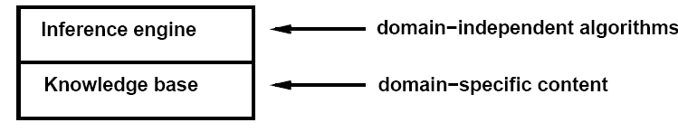
The Knowledge Base
A set of sentences
that encodes assertions about the world
in a formal knowledge representation language.
Initially contains some background knowledge.
Axiom: Sentence is taken as given without being derived from other sentences.
Inference: Deriving new sentences from old

Slide 10
Each time the agent program is called, it does three things:
TELLs the knowledge base what it perceives.
ASKs the knowledge base what action it should perform.
The agent program TELLs the knowledge base which action was chosen, and the agent executes the action
Tell it what it needs to know –add fact to KB.
Ask it what to do –compute using inference rules also in KB

Slide 11
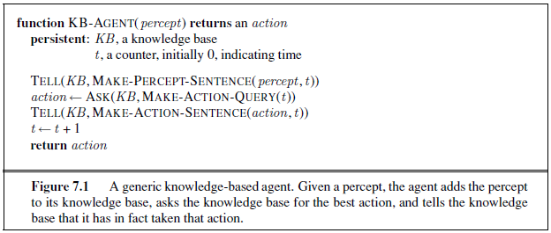
Generic KB-Based Agent Pseudocode
Agent must be able to:
Represent states and actions,
Incorporate new percepts
Update internal representation of the world
Deduce hidden properties of the world
Deduce appropriate actions – requires some logic of action

Slide 12
What is Logic?
Logic is a formal system for manipulating facts so that true conclusions may be drawn
“The tool for distinguishing between the true and the false” (Averroes)
Syntax: rules for constructing valid sentences
e.g., x + 2 ≥ y is a valid arithmetic sentence, ≥x2y + is not
Semantics: “meaning” of sentences, or relationship between logical sentences and the real world Specifically, semantics defines truth of sentences
e.g., x + 2 ≥ y is true in a world where x = 5 and y = 7

Slide 13
Types of Logics
Propositional Logic: concrete statements that are either true or false
E.g., It is raining.
Predicate Logic (also called first order logic, first order predicate calculus): allows statements to contain variables, functions, and quantifiers
For all X, Y: If X is married to Y then Y is married to X.
Fuzzy Logic: vague statements; paint is slightly grey; sky is very cloudy.

Slide 14
Propositional Logic: Syntax
Atomic sentence:
A proposition symbol representing a true or false statement
Negation:
If P is a sentence, ¬P is a sentence
Conjunction:
If P and Q are sentences, P ∧ Q is a sentence
Disjunction:
If P and Q are sentences, P ∨ Q is a sentence
Implication:
If P and Q are sentences, P ⇒ Q is a sentence
Biconditional:
If P and Q are sentences, P ⇔ Q is a sentence
¬, ∧, ∨, ⇒, ⇔ are called logical connectives

Slide 15
Propositional Logic: Semantics
A model specifies the true/false status of each proposition symbol in the knowledge base
e.g., P is true, Q is true, R is false
With three symbols, there are 8 possible models, and they can be enumerated exhaustively
Rules for evaluating truth with respect to a model:
¬P is true iff P is false
P ∧Q is true iff P is true and Q is true
P ∨ Q is true iff P is true or Q is true
P ⇒ Q is true iff P is false or Q is true
P ⇔ Q is true iff P ⇒Q is true and Q ⇒ P is true

Slide 16
P ⇒ Q = (¬P v Q)
“If P is true, then I am claiming that Q is true. Otherwise I am making no claim.”
P ⇔ Q, is true whenever both P ⇒ Q and Q ⇒ P are true. Or, “P if and only if Q.”

Slide 17
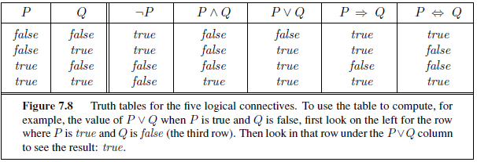

Slide 18
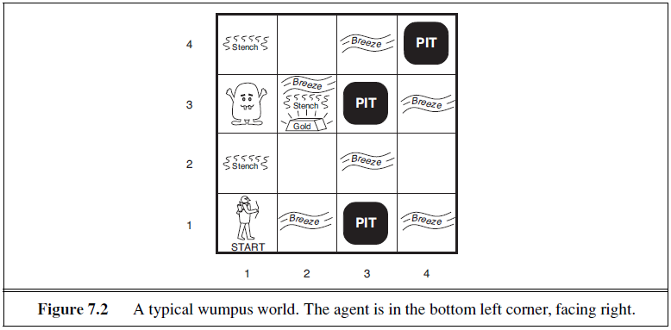
The Wumpus World

Slide 19
The Wumpus World
Sensors:
Returns a 5-tuple of five symbols e.g., [stench, breeze, glitter, bump, scream] (note that in this 5-tuple, all five things are present. We indicate absence with the value None)
In squares adjacent to the Wumpus, agent perceives a stench.
In squares adjacent to a pit, agent perceives a breeze
In squares adjacent to the gold agent perceives a glitter
When agent walks into a wall, it perceives a bump
When Wumpus is killed, it emits a woeful scream that is perceived anywhere.

Slide 20
The Wumpus World
Biggest challenge: Agent is ignorant of the configuration of the 4x4 world
Needs logical reasoning of percepts in order to overcome this ignorance
Note: retrieving gold may not be possible due to randomly generated location of pits
Initial knowledge base contains:
Agent knows it is in [1,1]
Agent knows it is a safe square

Slide 21
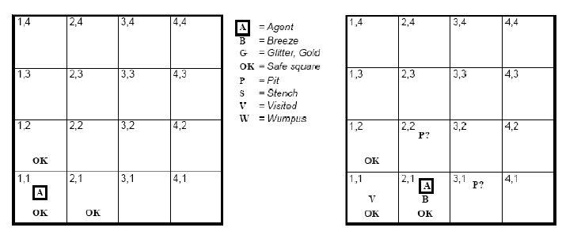
Wumpus World Example

Slide 22
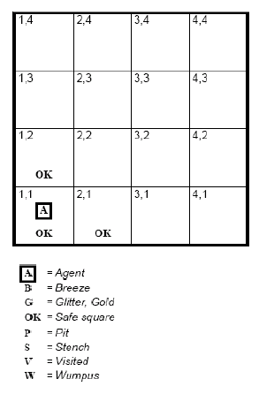
Wumpus World Example
1st percept is:
[None, None, None, None, None]
(Corresponding to [Stench, Breeze, Glitter, Bump, Scream])
Agent concludes squares [1,2], [2,1] are safe. We mark them with OK. A cautious agent will move only to a square that it knows is OK.
Agent now moves to [2,1]

Slide 23
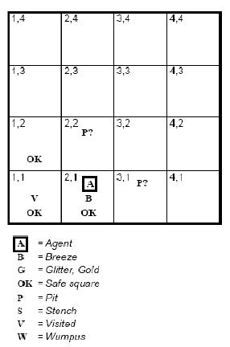
Wumpus World Example
2nd percept is:
[None, Breeze, None, None, None]
Must be a pit at [2,2] or [3,1] or both. We mark this with a P?.
Only one square that is OK, so the agent goes back to [1,1] and then to [1,2]

Slide 24
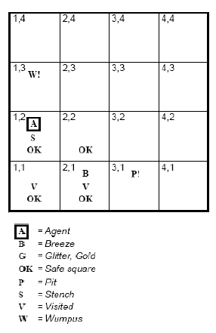
Wumpus World Example
3rd percept is:
[Stench, None, None, None, None]
Wumpus must be nearby. Can’t be in [1,1] (by rules of the game) or [2,2] (otherwise agent would have detected a stench at [2,1])
Therefore, Wumpus must be in [1,3]. Indicate this by W!.
Lack of breeze in [1,2] means no pit in [2,2], so pit must be in [3,1].

Slide 25
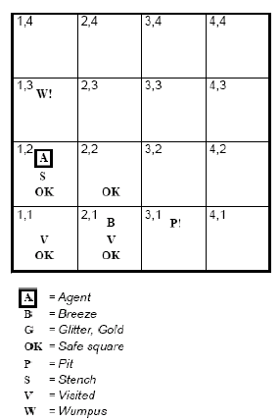
Wumpus World Example
Note the difficulty of this inference:
Combines knowledge gained at different times and at different places.
Relies on the lack of a percept to make one crucial step
At this point, the agent moves to [ 2,2].

Slide 26
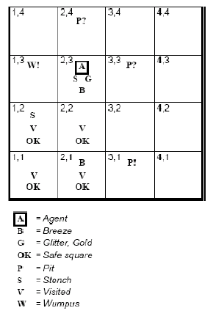
Wumpus World Example
We’ll skip the agent’s state of knowledge at [2,2] and assume it goes to [2,3].
Agent detects a glitter in [2,3] so it grabs the gold and ends the game
Note: In each case where the agent draws a conclusion from the available information, that conclusion is guaranteed to be correct if the available information is correct

Slide 27
Logic
Logic must define:
Syntax of the representation language
Symbols, rules, legal configurations
Semantics of the representation language
Loosely speaking, this is the “meaning” of the sentence
Defines the truth of each sentence with respect to each possible world
Everything is either true or false, no in between

Slide 28
Models
We will use the word model instead of “possible world”
“m is a model of α” means that sentence α is true in model m
Models are mathematical abstractions which fixes the truth or falsehood of every relevant sentence
Think of it as the possible assignments of values to the variables
e.g., the possible models for x + y = 4 are all possible assignments of numbers to x and y such that they add up to 4

Slide 29
Entailment
α |= β means α entails β i.e., β follows logically from α, where α and β are sentences
Mathematically, α |= β if and only if in every model in which α is true, β is also true.
Another way: if α is true, then β must also be true.

Slide 30
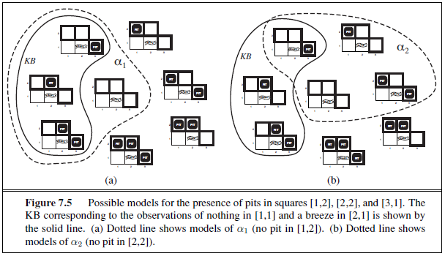

Slide 31
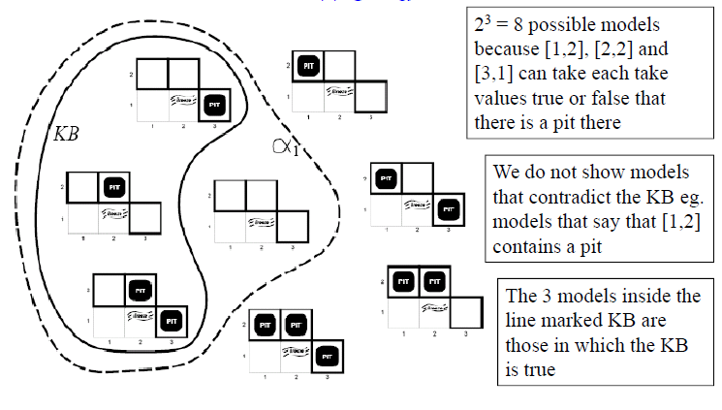
Entailment Applied to the Wumpus World

Slide 32
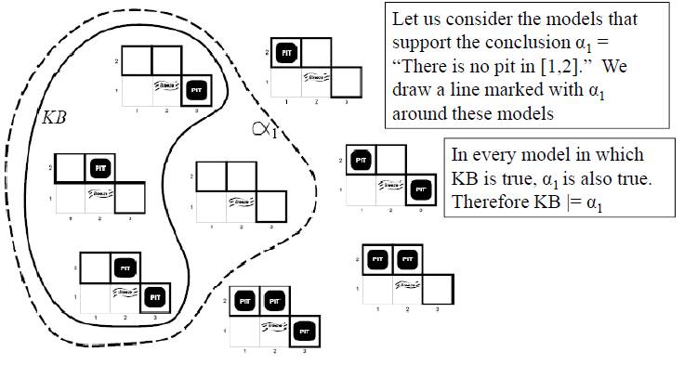
Entailment Applied to the Wumpus World

Slide 33
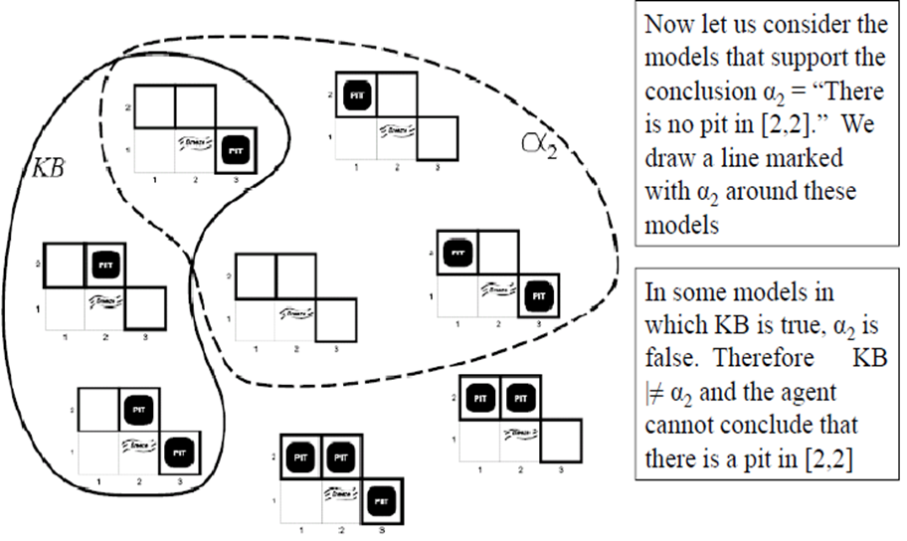
Entailment Applied to the Wumpus World

Slide 34
The inference algorithm illustrated in the preceding slides is called model checking, because it enumerates all possible models to check that α is true in all models in which KB is true, that is, that M(KB) ⊆ M(α).

Slide 35
Logical Inference
Entailment can be applied to derive conclusions (we call this carrying out logical inference)
Model checking: enumerates all possible models to check that α is true in all models in which KB is true
If an inference algorithm i can derive α from the KB, we write KB |- _{i} α
The above is pronounced “α is derived from KB by i” or “i derives α from KB”

Slide 36
Soundness
An inference algorithm that derives only entailed sentences is called sound or truth-preserving
Soundness is a good thing!
If an inference algorithm is unsound, you can make things up as it goes along and derive basically anything it wants to

Slide 37
Completeness
An inference algorithm is complete if it can derive any sentence that is entailed
For some KBs, the number of sentences can be infinite
Can’t exhaustively check all of them, need to rely on proving completeness

Slide 38
In Summary
Soundness: i is sound if whenever KB |- _{i} α, it is also true that KB |= α
Completeness: i is complete if whenever KB |= α, it is also true that KB |-_{i} α

Slide 39
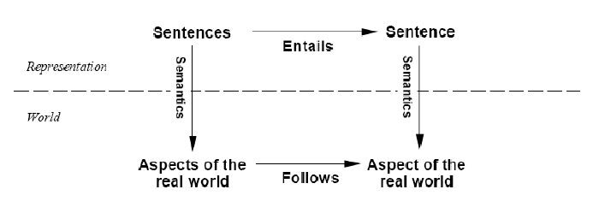
Correspondence to the Real World
If the KB is true in the real world, then any sentence α derived from the KB by a sound inference procedure is also true in the real world.

Slide 40
Grounding
Defined as the connection, if any, between logical reasoning processes and the real environment in which the agent exists
How do we know that the KB is true in the real world?
Deep philosophical question
We’ll respond with the following:
Rely on sensors to accurately perceive the world
Learning produces general rules (derived from perceptual experience). Learning can be fallible but it has the potential to fix its mistakes.

Slide 41
Things you should know
Properties of a knowledge-based agent
What a knowledge-base is
What entailment and inference mean
Desirable properties of inference algorithms such as soundness and completeness

Slide 42
Review
|= means “logically follows”
|-_{i} means “can be derived from”
If your inference algorithm derives only things that follow logically from the KB, the inference is sound
If everything that follows logically from the KB can be derived using your inference algorithm, the inference is complete

Slide 43
Propositional Logic: Syntax and Semantics

Slide 44
Syntax: Backus-Naur Form Grammar of Sentences in Propositional Logic
Sentence → AtomicSentence | ComplexSentence
AtomicSentence → True | False | Symbol
Symbol → P | Q | R | …
ComplexSentence → ¬ Sentence
| ( Sentence ∧ Sentence )
| ( Sentence ∨ Sentence )
| ( Sentence ⇒ Sentence )
| ( Sentence ⇔ Sentence )

Slide 45
Atomic Sentences
The indivisible syntactic elements
Consist of a single propositional symbol e.g., P, Q, R that stands for a proposition that can be true or false eg. P=true, Q=false
We also call an atomic sentence a literal
2 special propositional symbols:
True (the always true proposition)
False (the always false proposition)

Slide 46
Complex Sentences
Made up of sentences (either complex or atomic)
5 common logical connectives:
¬ (not): negates a literal
∧ (and): conjunction e.g., P ∧ Q where P and Q are called the conjuncts
∨ (or): disjunction e.g., P ∨ Q where P and Q are called the disjuncts
⇒ (implies): e.g., P ⇒ Q where P is the premise/antecedent and Q is the conclusion/consequent
⇔ (if and only if): e.g., P ⇔ Q is a bi-conditional

Slide 47
Precedence of Connectives
In order of precedence, from highest to lowest: ¬, ∧, ∨, ⇒, ⇔
e.g., ¬P ∨ Q ∧ R ⇒ S is equivalent to
((¬P) ∨ (Q ∧ R)) ⇒ S
You can rely on the precedence of the connectives or use parentheses to make the order explicit
Parentheses are necessary if the meaning is ambiguous

Slide 48
Semantics (Are sentences true?)
Defines the rules for determining if a sentence is true with respect to a particular model
For example, suppose we have the following model: P=true, Q=false, R=true
Is (P ∧ Q ∧ R) true?

Slide 49
Semantics
For atomic sentences:
True is true, False is false
A symbol has its value specified in the model
For complex sentences (for any sentence S and model m):
¬S is true in m iff S is false in m
S1 ∧ S2 is true in m iff S1 is true in m and S2 is true in m
S1 ∨ S2 is true in m iff S1 is true in m or S2 is true in m
S1 ⇒ S2 is true in m iff S1 is false in m or S2 is true in m i.e., can translate it as ¬S1 ∨ S2
S1 ⇔ S2 is true iff S1⇒S2 is true in m and S2⇒S1 is true in m

Slide 50
Note on Implication
P ⇒ Q seems weird…doesn’t fit intuitive understanding of “if P then Q”
Propositional logic does not require causation or relevance between P and Q
Implication is true whenever the antecedent is false (remember P ⇒ Q can be translated as ¬ P ∨ Q )
Implication says “if P is true, then I am claiming that Q is true. Otherwise I am making no claim”
The only way for this to be false is if P is true but Q is false

Slide 51
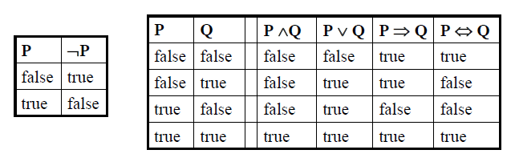
Truth Tables for the Connectives
With the truth tables, we can compute the truth value of any sentence with a recursive evaluation eg.
Suppose the model is P=false, Q=false, R=true
¬P ∧ (Q ∨ R) = true ∧ (false ∨ true) = true ∧ true = true

Slide 52
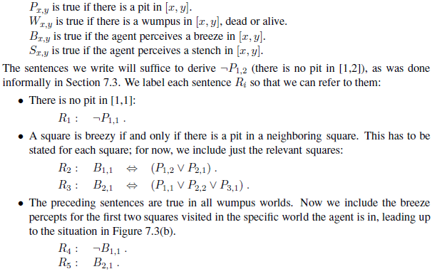
The Wumpus World KB (only dealing with knowledge about pits)

Slide 54
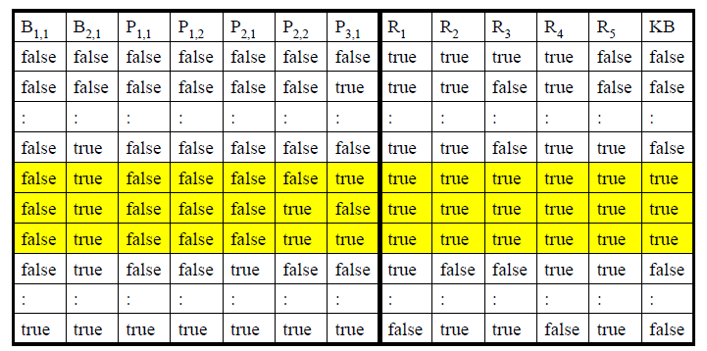
Inference
How do we decide if KB |= α?
Enumerate the models, check that α is true in every model in which KB is true

Slide 55
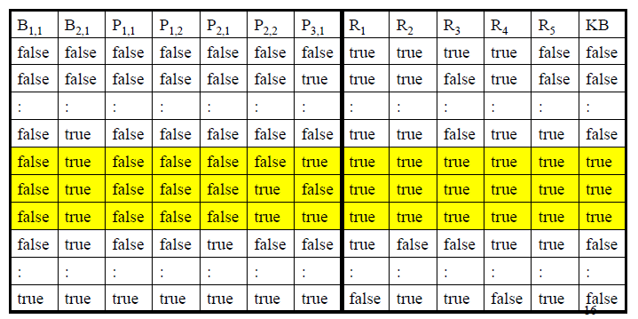
Suppose we want to know if KB |= ¬P_{1,2}?
In the 3 models in which KB is true, ¬P_{1,2} is also true
On the other hand, there might (or might not) be a pit in [2,2].

Slide 56
Complexity
If the KB and α contain n symbols in total, the time complexity of the truth table enumeration algorithm is O(2^{n})?
Space complexity is O(n) because the actual algorithm uses DFS
Every known inference algorithm for propositional logic has a worse-case complexity that is exponential in the size of the input
But some algorithms are more efficient in practice

Slide 57
Logical Equivalence
Intuitively: two sentences α and β are logically equivalent (i.e., α ≡ β ) if they are true in the same set of models
Formally: α ≡ β if and only if α |= β and β |= α
Can prove this with truth tables

Slide 58
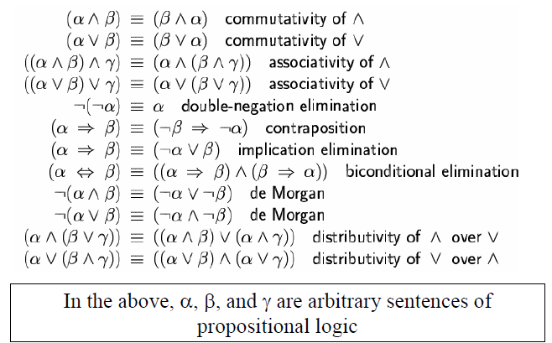
Standard Logic Equivalences

Slide 59
Validity
A sentence is valid if it is true in all models
e.g., P ∨ ¬P is valid
Valid sentences = Tautologies
Tautologies are vacuous
Deduction theorem
For any sentences α and β, α |= β iff the
sentence (α ⇒ β) is valid

Slide 60
Satisfiability
A sentence is satisfiable if it is true in some model.
A sentence is unsatisfiable if it is true in no models
Determining the satisfiability of sentences in propositional logic was the first problem proved to be NP-complete
Satisfiability is connected to validity:
α is valid iff ¬α is unsatisfiable
Satisfiability is connected to entailment:
α |= β iff the sentence (α ∧¬β) is unsatisfiable
(proof by contradiction)

Slide 61
Reasoning Patterns in Propositional Logic

Slide 62
Proof Methods
How do we prove that α can be entailed from the KB?
Model checking e.g., check that α is true in all models in which KB is true
Inference rules

Slide 63
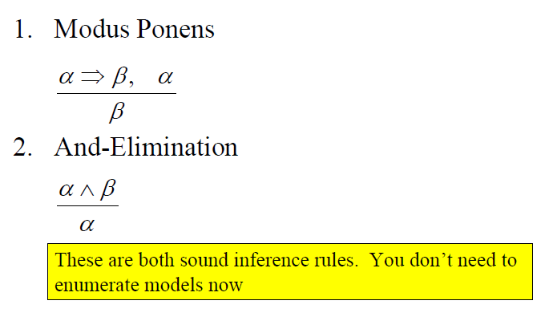
Inference Rules

Slide 64
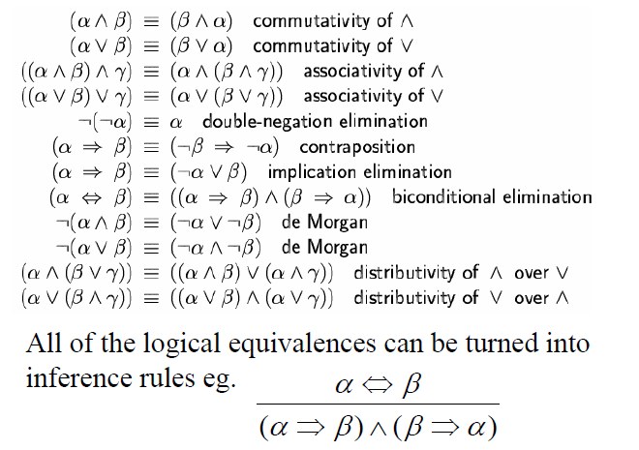
Other Inference Rules

Slide 65
Example
Given the following KB, can we prove ¬R?
KB:
P ⇒ ¬(Q ∨ R)
P
Proof:
¬(Q ∨ R) by Modus Ponens
¬Q ∧ ¬R by De Morgan’s Law
¬R by And-Elimination

Slide 66
Proofs
A sequence of applications of inference rules is called a proof
Instead of enumerating models, we can search for proofs
Proofs ignore irrelevant propositions
2 methods:
Go forward from initial KB, applying inference rules to get to the goal sentence
Go backward from goal sentence to get to the KB

Slide 67
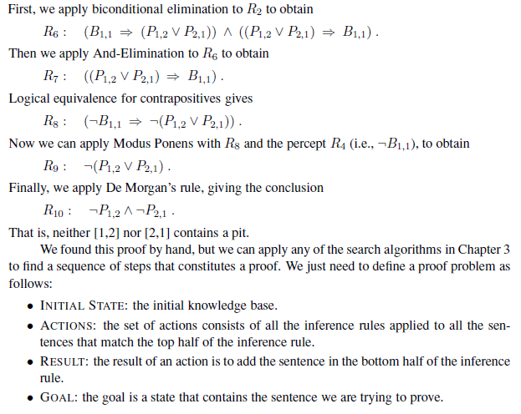
We start with the knowledge base containing R1 through R5 and show how to prove ¬P1,2, that is, there is no pit in [1,2].

Slide 68
Monotonicity
Proofs only work because of monotonicity
Monotonicity: the set of entailed sentences can only increase as information is added to the knowledge base
For any sentences α and β,
if KB |= α then KB ∧ β |= α

Slide 69
Resolution
An inference rule that is sound and complete
Forms the basis for a family of complete inference procedures
Here, complete means refutation completeness: resolution can refute or confirm the truth of any sentence with respect to the KB.
Unit resolution

Slide 70
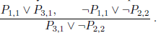
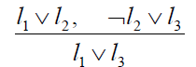
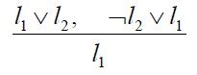
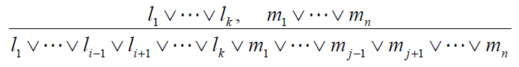
Resolution
Here’s how resolution works (¬l₂ and l₂ are called complementary literals):
Note that you need to remove multiple copies of literals (called factoring) i.e.,
If l_{i} and m_{j} are complementary literals, the full resolution rule looks like:

Slide 71
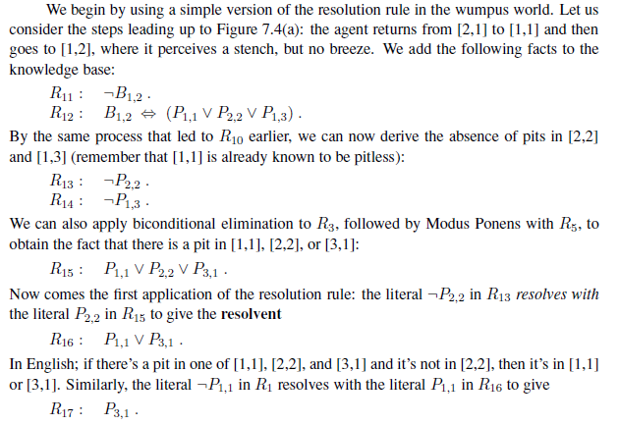

Slide 72
There is one more technical aspect of the resolution rule: the resulting clause should contain only one copy of each literal. The removal of multiple copies of literals is called factoring.
For example, if we resolve (A ∨ B) with (A∨¬B), we obtain (A ∨ A), which is reduced to just A.

Slide 73
Conjunctive Normal Form
Resolution only applies to sentences of the form
l₁ ∨ l₂ ∨ … ∨ l_{k}
This is called a disjunction of literals
It turns out that every sentence of propositional logic is logically equivalent to a conjunction of disjunction of literals
Called Conjunctive Normal Form or CNF
e.g., (l₁ ∨ l₂ ∨ l₃ ∨ l₄) ∧ (l₅ ∨ l₆ ∨ l₇ ∨ l₈) ∧ …
k-CNF sentences have exactly k literals per clause e.g., A 3-CNF sentence would be
(l₁ ∨ l₂ ∨ l₃) ∧ (l₄ ∨ l₅ ∨ l₆) ∧ (l₇ ∨ l₈ ∨ l₉)

Slide 74
Recipe for Converting to CNF
Eliminate ⇔, replacing α ⇔ β with (α ⇒ β) ∧ (β ⇒ α)
Eliminate ⇒, replacing α ⇒ β with ¬α ∨ β
Move ¬ inwards using:
¬(¬α) ≡ α (double-negation elimination)
¬(α ∧ β) ≡ ¬α ∨ ¬β (De Morgan’s Law)
¬(α ∨ β) ≡ ¬α ∧ ¬β (De Morgan’s Law)
Apply distributive law (α ∨ (β ∧ γ)) ≡ ((α ∨ β) ∧ (α ∨ γ))
(Example next slide)

Slide 75

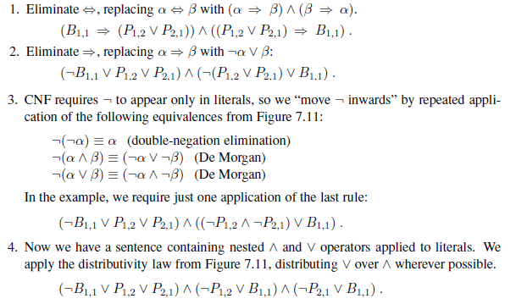

Slide 76
Satisfiability
A sentence is satisfiable if it is true in, or satisfied by, some model.
For example, the knowledge base given earlier, (R1 ∧ R2 ∧ R3 ∧ R4 ∧ R5), is satisfiable because there are three models in which it is true.
Satisfiability can be checked by enumerating the possible models until one is found that satisfies the sentence.
For example, all the constraint satisfaction problems in Chapter 6 ask whether the constraints are satisfiable by some assignment.
Validity and satisfiability are of course connected: α is valid iff ¬α is unsatisfiable; contrapositively, α is satisfiable iff ¬α is not valid.

Slide 77
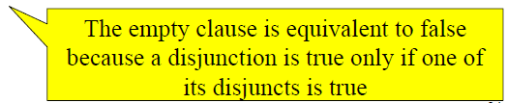
A resolution algorithm
To prove KB |= α, we show that (KB ∧ ¬α) is unsatisfiable
(Remember that α |= β iff the sentence (α ∧¬β) is unsatisfiable)
The algorithm:
Convert (KB ∧ ¬α) to CNF
Apply resolution rule to resulting clauses. Each pair with complementary literals is resolved to produce a new clause which is added to the KB
Keep going until
There are no new clauses that can be added
(meaning KB |≠ α)
Two clauses resolve to yield the empty clause
(meaning KB |= α )
(P and ¬P) = Emptyset

Slide 78
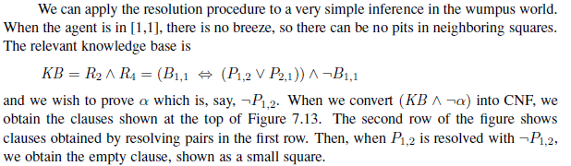
7.13 is shown after next slide

Slide 79
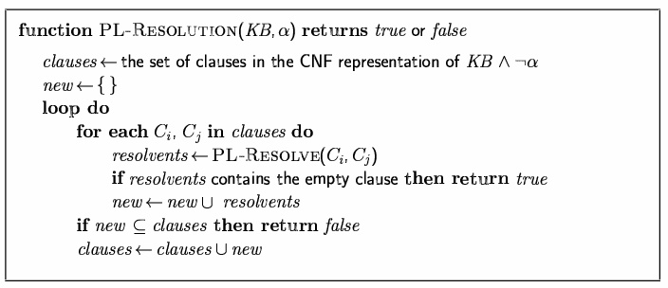
Resolution Pseudocode

Slide 80
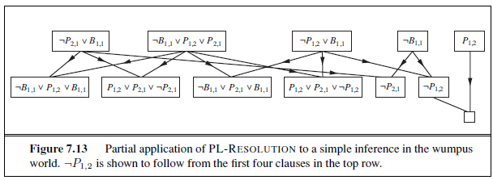

Slide 81
Definite and Horn clauses
DEFINITE CLAUSE, which is a disjunction of literals of which exactly one is positive. For example, the clause (¬L1,1 ∨¬Breeze ∨B1,1) is a definite clause, whereas (￢B1,1 ∨ P1,2 ∨ P2,1) is not.
Slightly more general is the Horn clause, which is a disjunction of literals of which at most one is positive. So all definite clauses are Horn clauses, as are clauses with no positive literals; these are called goal clauses. Horn clauses are closed under resolution: if you resolve two Horn clauses, you get back a Horn clause.

Slide 82
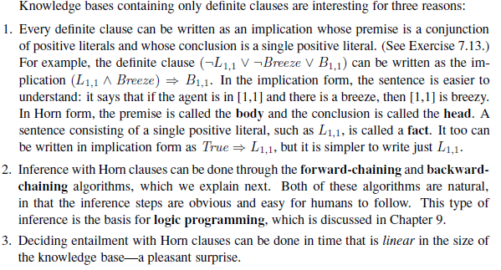

Slide 83
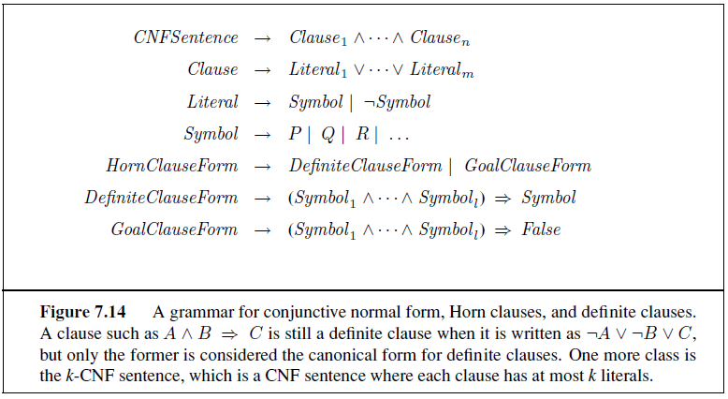

Slide 84
Forward chaining -> Data driven reasoning
Backward chaining -> Goal directed reasoning

Slide 85
Forward chaining
The forward-chaining algorithm determines if a single proposition symbol q—the query—is entailed by a knowledge base of definite clauses.
It begins from known facts (positive literals) in the knowledge base. If all the premises of an implication are known, then its conclusion is added to the set of known facts.
For example, if L1,1 and Breeze are known and (L1,1 ∧ Breeze) ⇒ B1,1 is in the knowledge base, then B1,1 can
be added.
This process continues until the query q is added or until no further inferences can be made.

Slide 86
The backward-chaining algorithm, as its name suggests, works backward from the query.
If the query q is known to be true, then no work is needed.
If all the premises of one of those implications can be proved true (by backward chaining), then q is true.

Slide 87
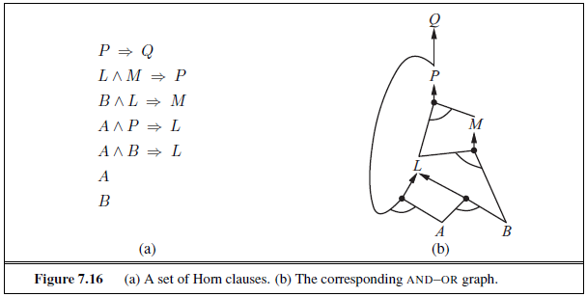

Slide 88
Things you should know
Understand the syntax and semantics of propositional logic
Know how to do a proof in propositional logic using inference rules
Know how resolution works
Know how to convert arbitrary sentences to CNF

